Slide 1
Introduction
Variability in the ROC curve
R Shiny App Application
Variability in the covariate-specific ROC curve
ROC regression accounting for demographic effect

Slide 2
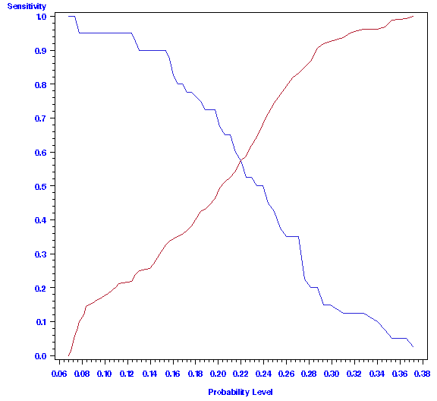
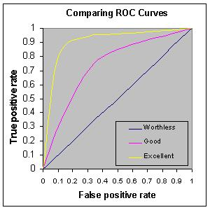
ROC Curve (Zhou, et al., 2009; Pepe, 2004)
For a given cut-point c,
Sensitivity = proportion of genuine scores > c
Specificity = proportion of imposter score ≤ c
Sensitivity
Specificity
Sensitivity
1 - specificity=FPR
The area under the ROC curve (AUC) is a measure of classification accuracy.

Slide 3
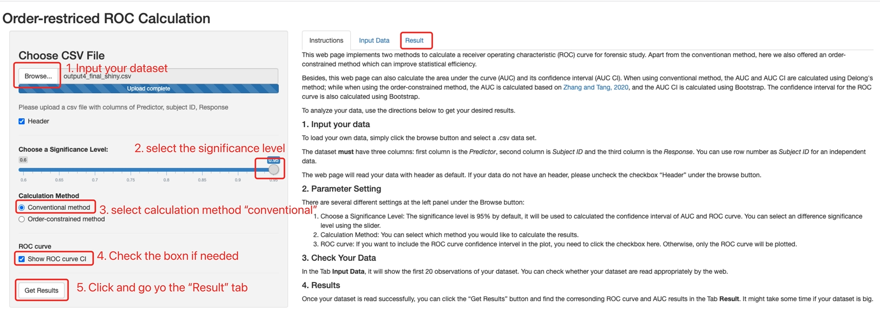
Variability of ROC Curve
Use the R Shiny application: https://menglingheshiny.shinyapps.io/orderROCweb/
Notes:
I wrote this website.

Slide 4
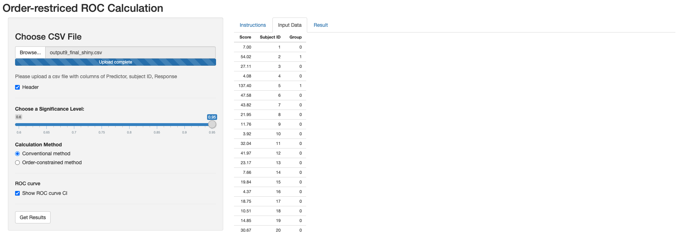
Variability of ROC Curve

Slide 5
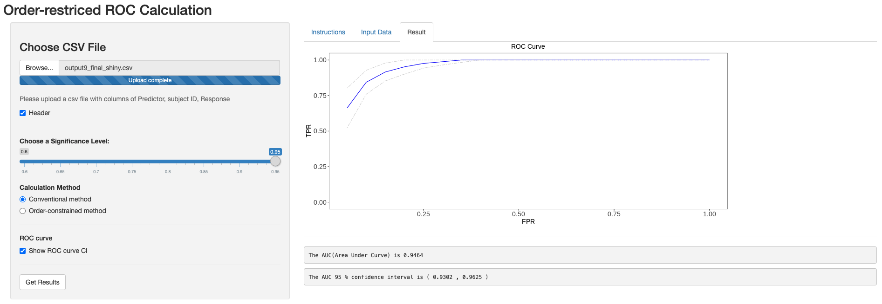
Variability of ROC Curve
AUC and AUC variance: Delong’s method
Elizabeth R. DeLong, D.M.D., Clarke-Pearson, D.L (1988)

Slide 6
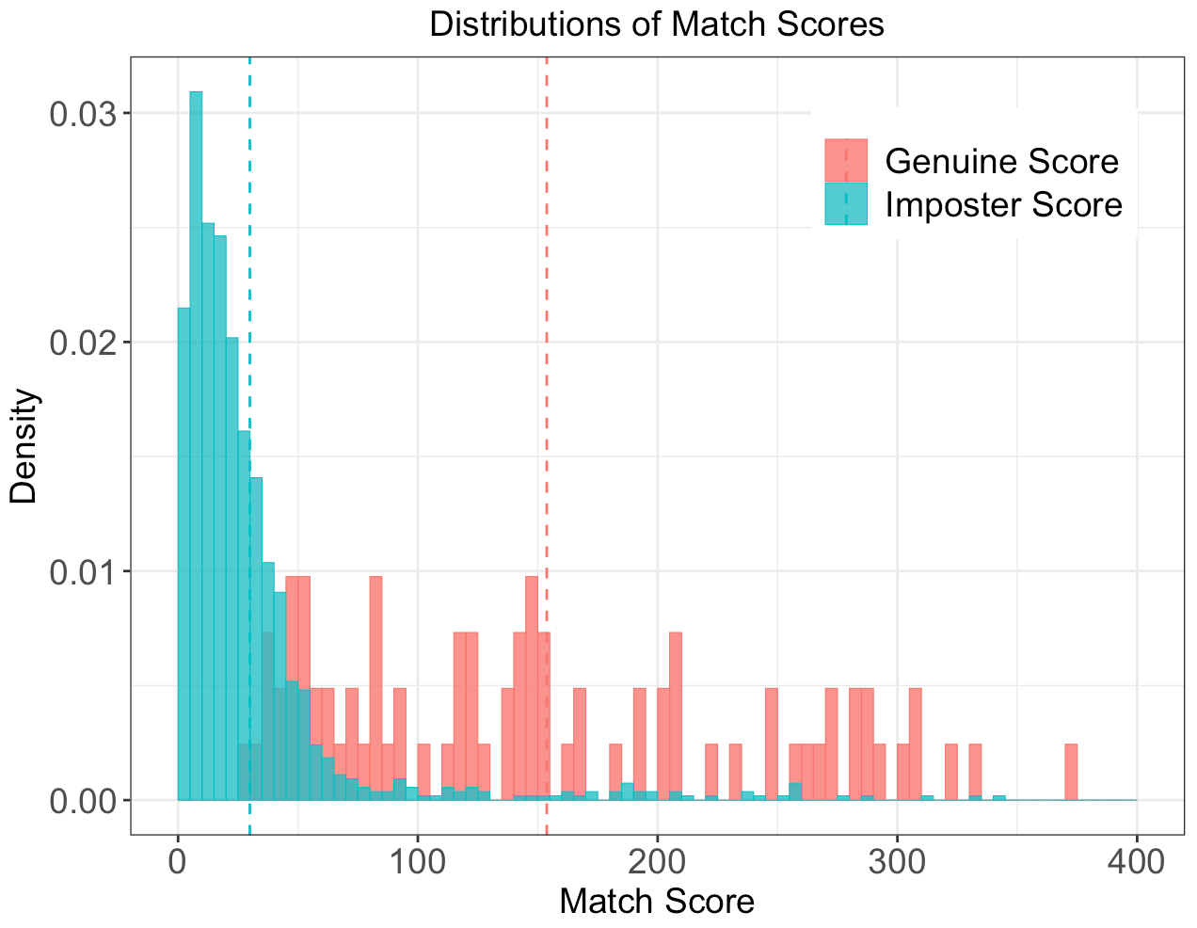
Dataset
Dataset used in the pooled ROC and covariate-specific ROC curve is a subset of the 2012 West Virginia University's FBI BIOCOP
Response variable: Match score
Genuine score: the score obtained by comparing two fingerprint images of the same source
Impostor score : the score that generated by comparing fingerprint images of two different sources
Covariates: Gender; age; ethnicity

Slide 7
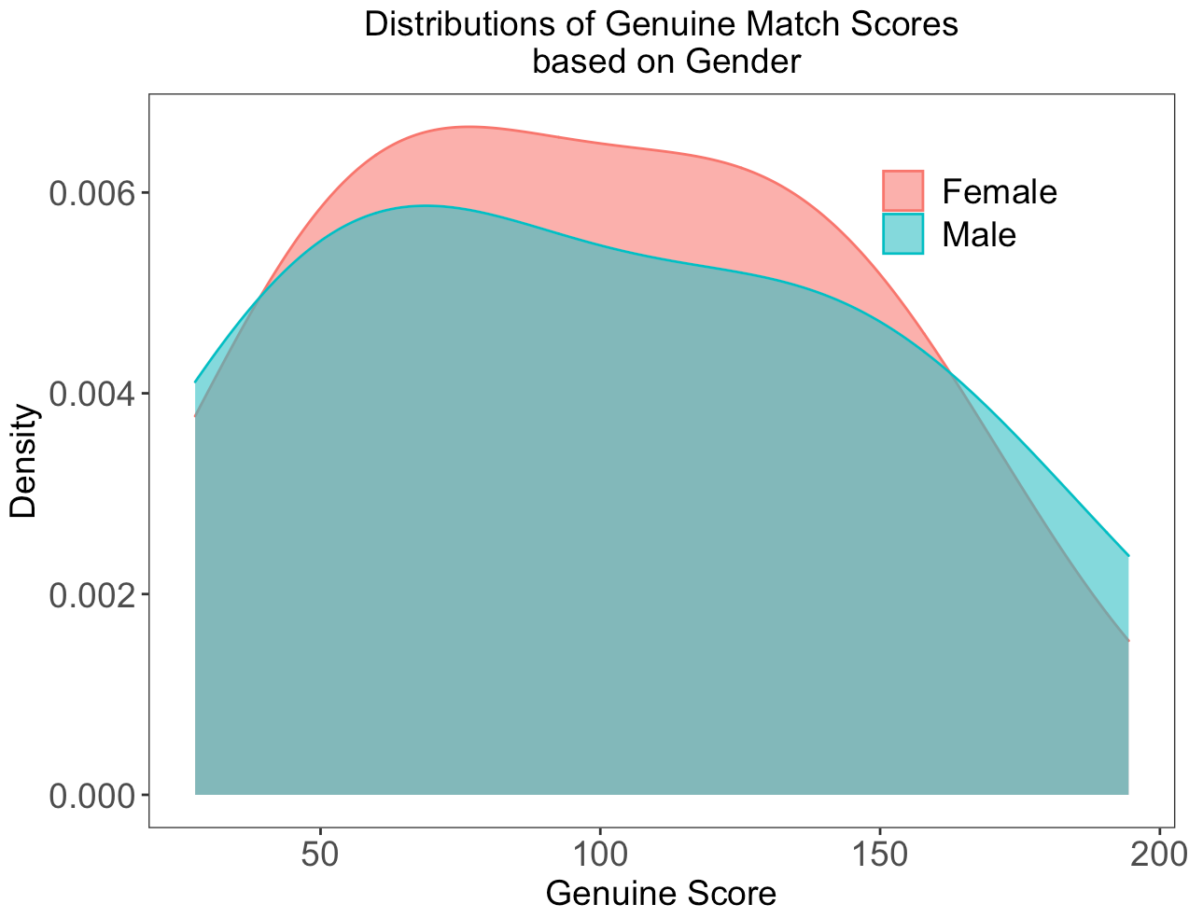
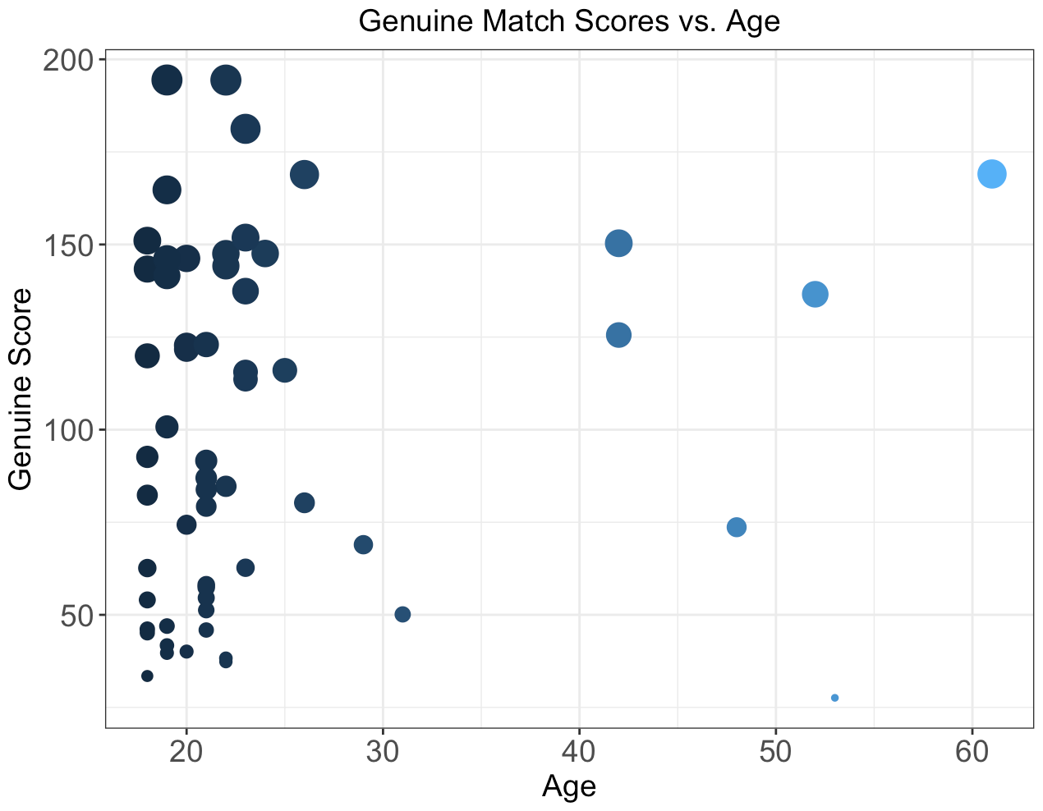
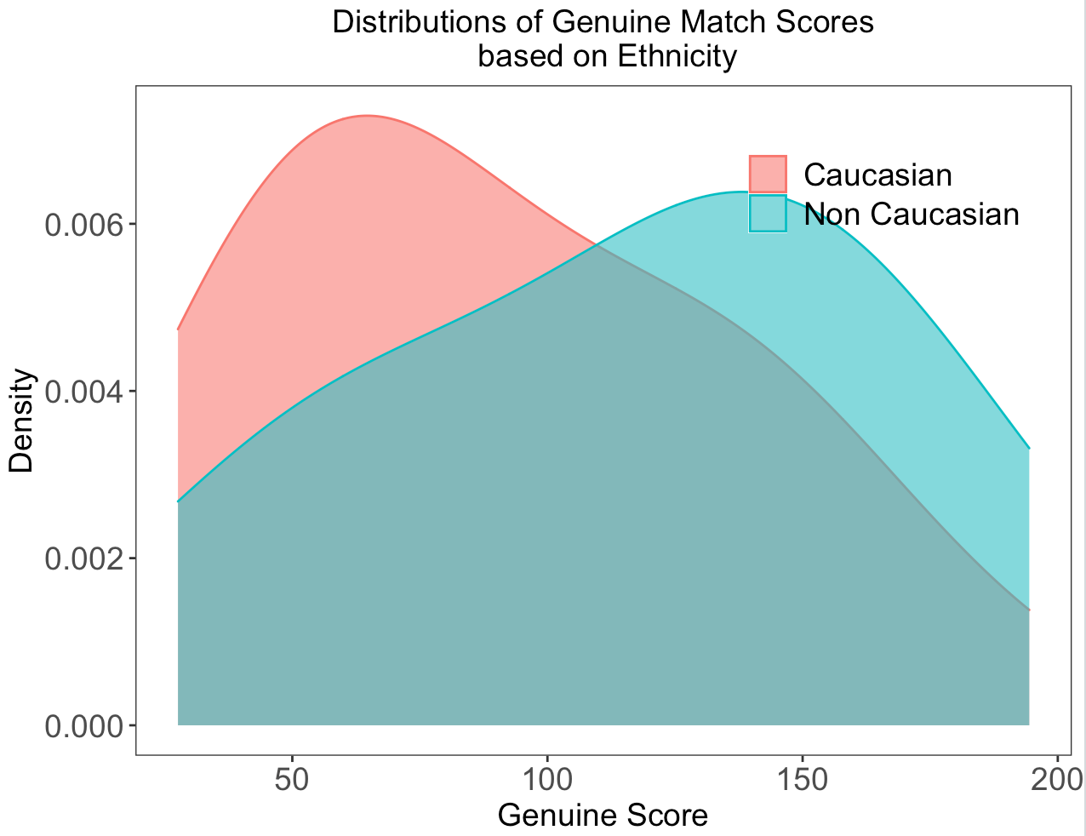
Motivation for Covariate-specific ROC Curve (Pepe, 2004)
Fingerprint match scores vary based on demographics.
How will demographics impact the fairness of the algorithm?

Slide 8

Covariate-specific ROC Curve Method (Pepe, 2004)
$$ROCx\left(u\right)=1−G1[{G0}^{−1}\left(1−u\right)\frac{σ0\left(x\right)}{σ1\left(x\right)}−\frac{μ1(x)−μ0(x)}{σ1(x)}]$$
𝑅𝑂𝐶_{𝑥(}𝑢)=1−𝐺₁[〖𝐺_{0〗^(}−1) (1−𝑢) 𝜎₀₍𝑥)/𝜎₁₍𝑥) −(𝜇₁(𝑥)−𝜇₀(𝑥))/(𝜎₁(𝑥))]
Covariate-specific ROC curve
Linear Regression
Notes:
G0 and G1 denote the CDFs of e0 and e1, respectively. e0 and e1 are zero-mean and unit variance random variables representing the base distributions for D = 0 and D = 1, respectively. which is independent of x;
sigma0(X;↵0⇤) and sigma1(X;↵1⇤) are non-negative scale functions depending on X and an unknown parameter ↵0⇤ and ↵1⇤, respectively.

Slide 9
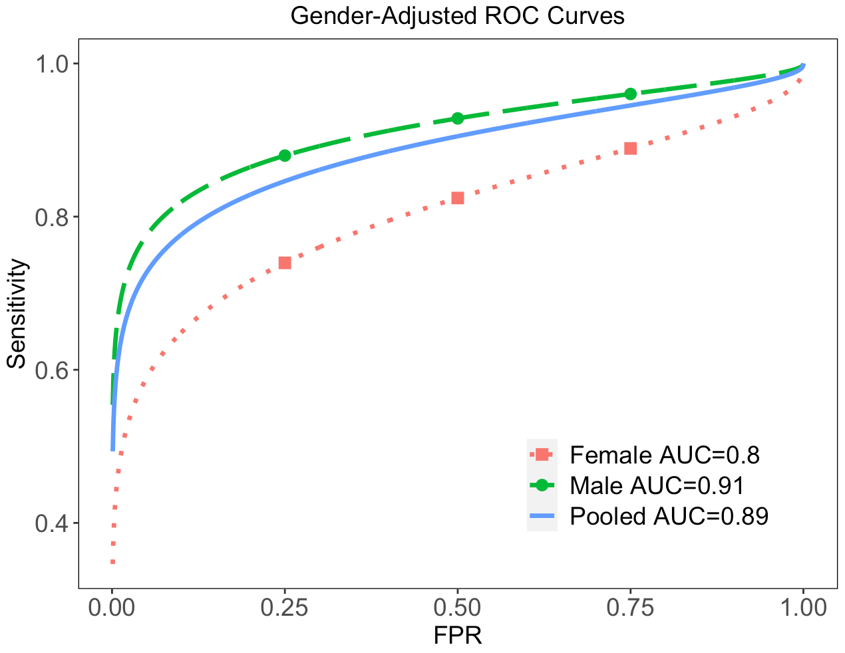
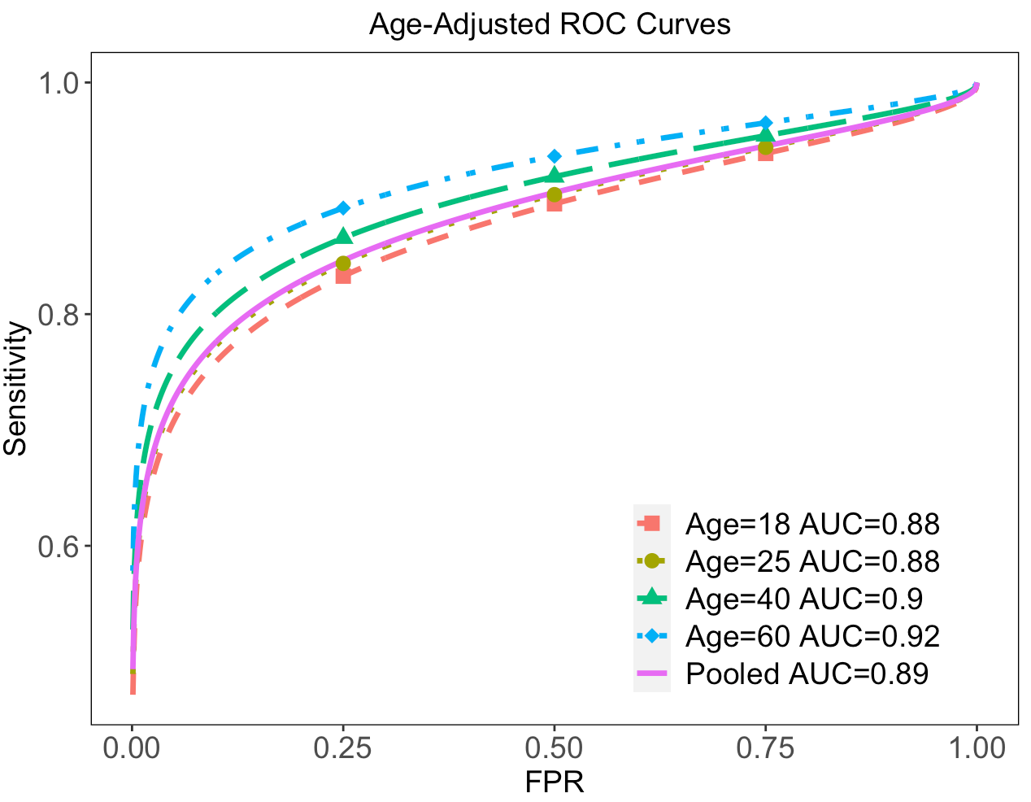
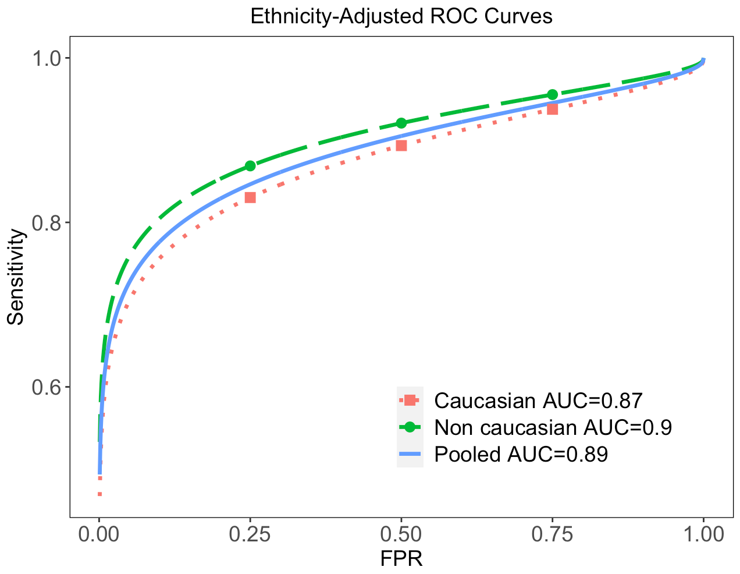
Univariate ROC Regression Model Results
In source identification problems
Gender: Algorithm performs significantly better for male subjects
Age: Algorithm performance better for older subjects.
Ethnicity: Algorithm performs better in Non-Caucasian subjects than the Caucasian ones
Emanuela Marasco, Mengling He, Larry Tang and Sumanth Sriram. (2020)

Slide 10
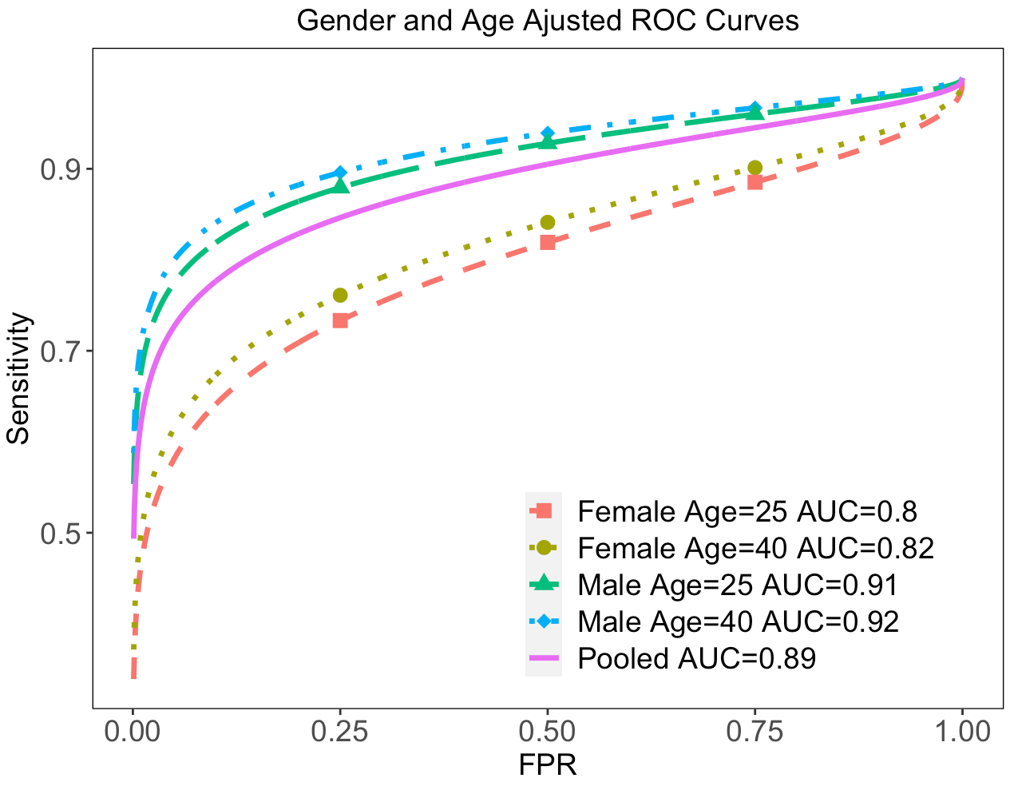
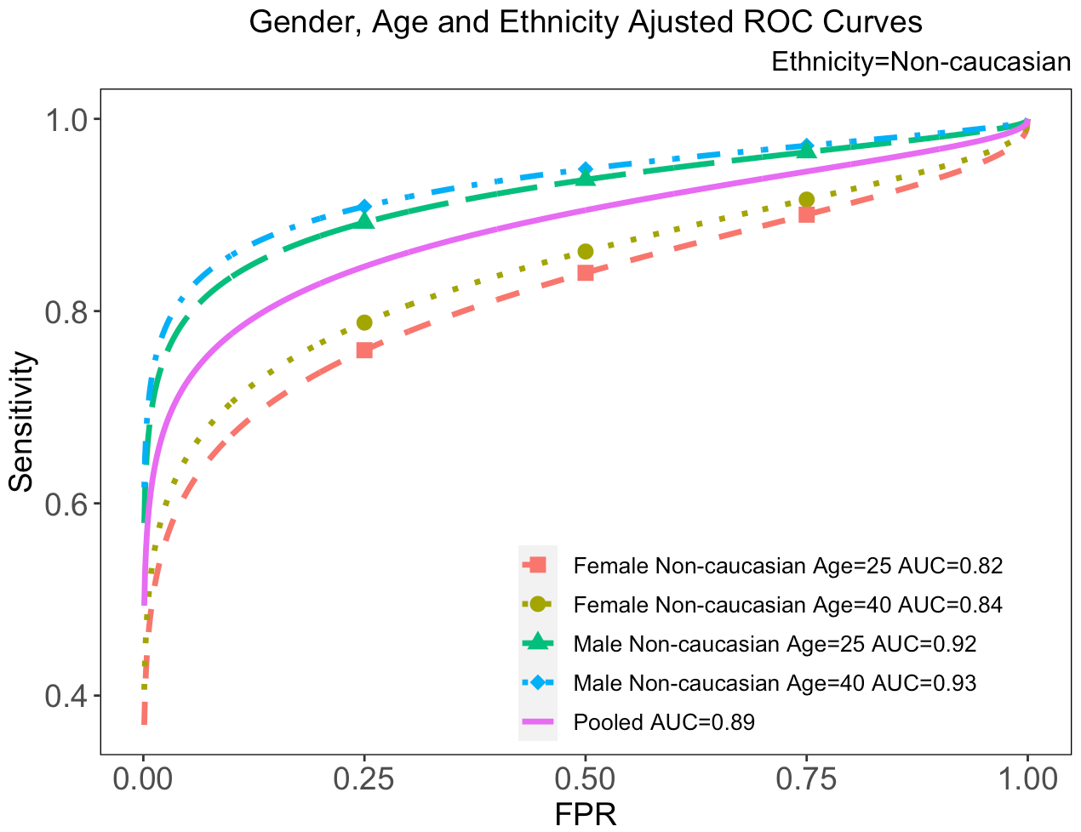
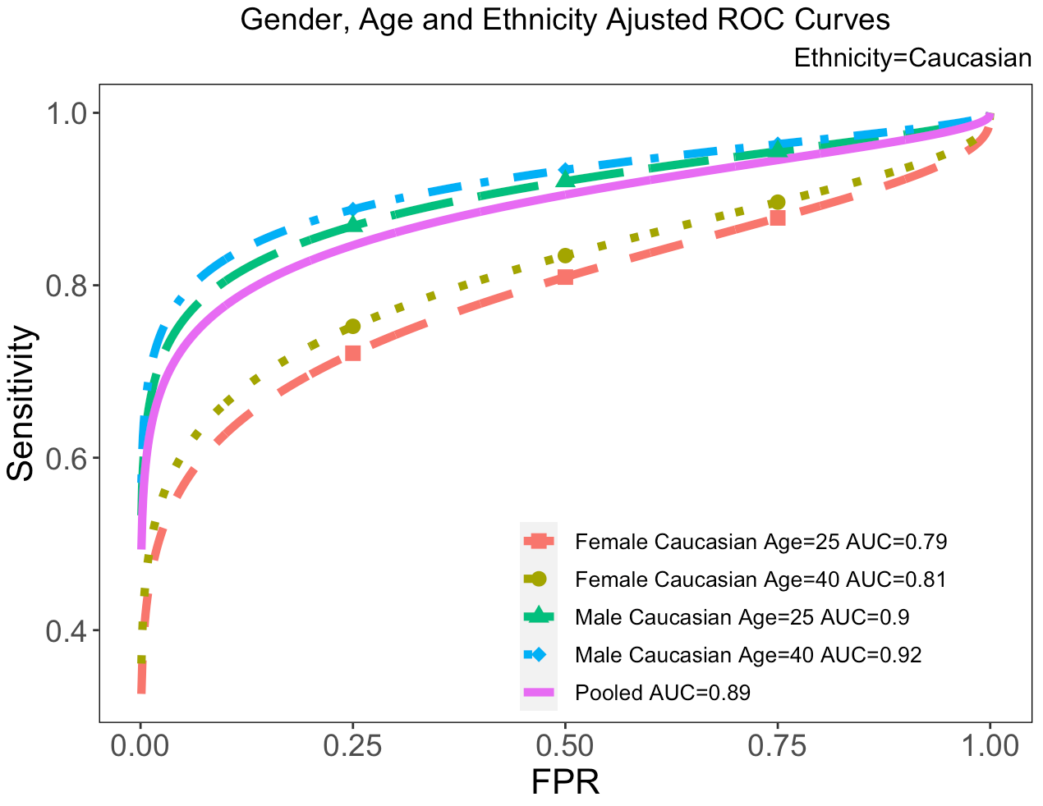
Multivariate ROC Regression Model Results
Notes:
Similar results.

Slide 11
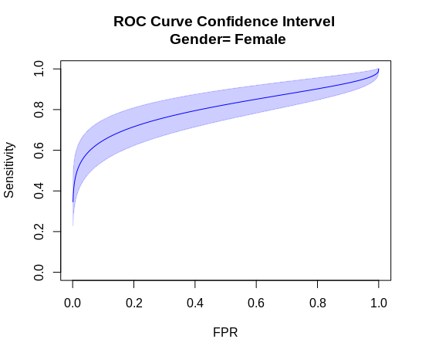
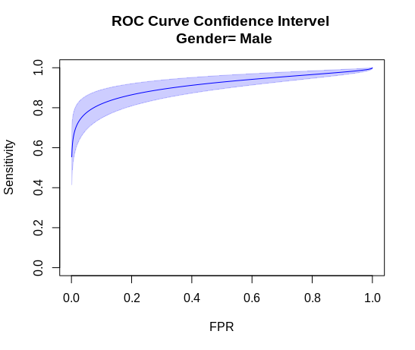
Variability of Covariate-Specific ROC Curve
Bootstrap method is used to estimate the variance of covariate-specific ROC curves.
The regression models are run for 5000 bootstrap samples drawn from the original data set.
The variance of TPR at each FPR point is calculated based on the parameter estimates from each model.
95% confidence interval

Slide 12
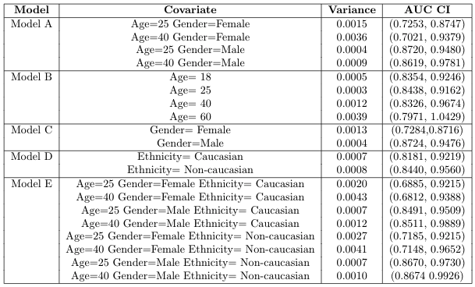
Variability of Covariate-Specific AUC

